Slide 1
Multimedia,
Graphics &
Hardware
FFmpeg
mpv
VLC
Hardware Acceleration
Lossy Compression
Lossless Compression
OpenGL
Direct3D
Vulkan
METAL
Decoding
Rendering
Streaming
Codecs
Formats
Containers
CPU
GPU
Hitesh Kumar Saini
56195
@alexmercerind
@alexmercerind
Course Instructor: Dr. Subodh Prasad
Department of Information Technology, College of Technology, G. B. P. U. A. & T., Pantnagar.

Slide 2

Introduction:
Video: Pixel, frame & representations.
Every video file consists of individual frames.
Every video frame consists of individual pixels.
Every video pixel consists of 3 channels: Red, Green & Blue (RGB).
  Not necessary!
    Other pixel formats exist: RGB, RGBA, BGRA, ARGB, YUV, NV12 etc. etc.
    Generally only relevant for in-memory (CPU RAM) representation.
A video pixel!

Slide 3
Introduction:
Video: Pixel, frame & representations.
Each pixel essentially represents a color (using RGB channel).
Web-developers may already understand:
  Familiar representations:
    rgb(120, 80, 35)
    rgba(120, 80, 35, 255)
    #121212
    #121212ff
Each channel (R, G & B) has a range of 0 to 255.
Can be represented/stored in 8 bits i.e.
  2⁸ = 256.
Thus, memory taken by each RGB pixel = 8 * 3 bits = 24 bits = 3 bytes
Thus, memory taken by each RGBA pixel = 8 * 4 bits = 32 bits = 4 bytes
Thus, memory taken by RGB FHD 1080p frame = 3 * 1920 * 1080 bytes
Thus, memory taken by RGBA FHD 1080p frame = 4 * 1920 * 1080 bytes

Slide 4
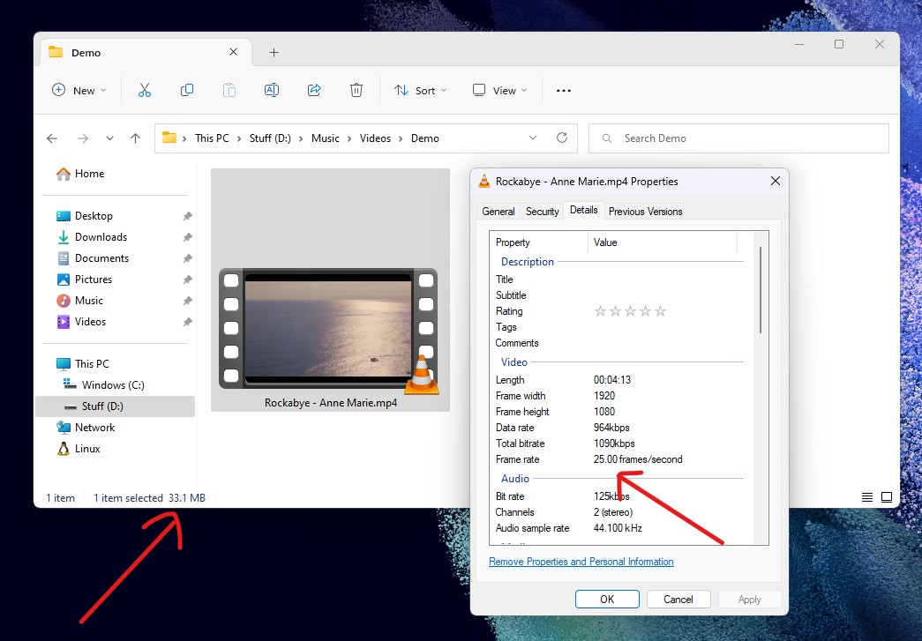
Introduction:
Video: Pixel, frame & representations.
Size of a 25 FPS FHD video of 1 second in bytes:
= 25 * 4 * 1920 * 1080 bytes
= 207,360,000 bytes
= 207,360,000 / (1024 * 1024) MB
= 197.75 MB!
For comparison, here’s a 25 FPS FHD video of 4:13 minute (253 seconds) consuming only 33.10 MB. You might already be familiar with size of video files downloaded from the internet.
What makes it possible?
  Compression Algorithms.
  File Information:
    Video Stream: H.264
    Audio Stream: AAC

Slide 5
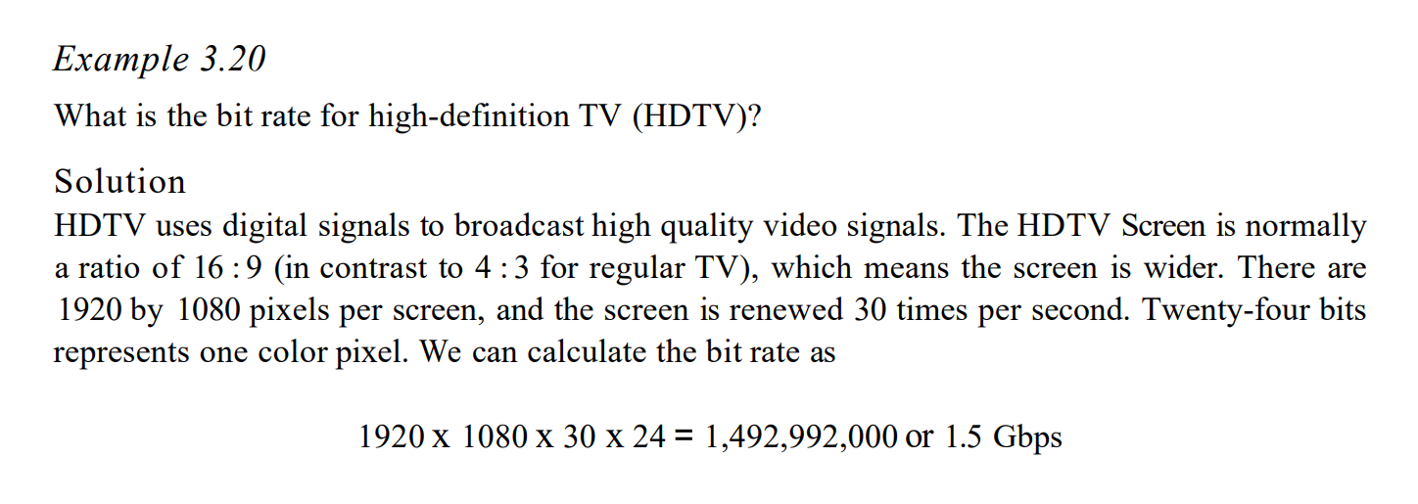
Introduction:
An example problem from “Data Communications & Networking” by Behrouz A. Forouzan.
Questions worth consideration:
Why multiplied by 24?
What makes it possible transmitting (network) & displaying (locally) at this extremely high rate & magnitude.
  ANSWER: Compression
  Hardware Acceleration
  …

Slide 6
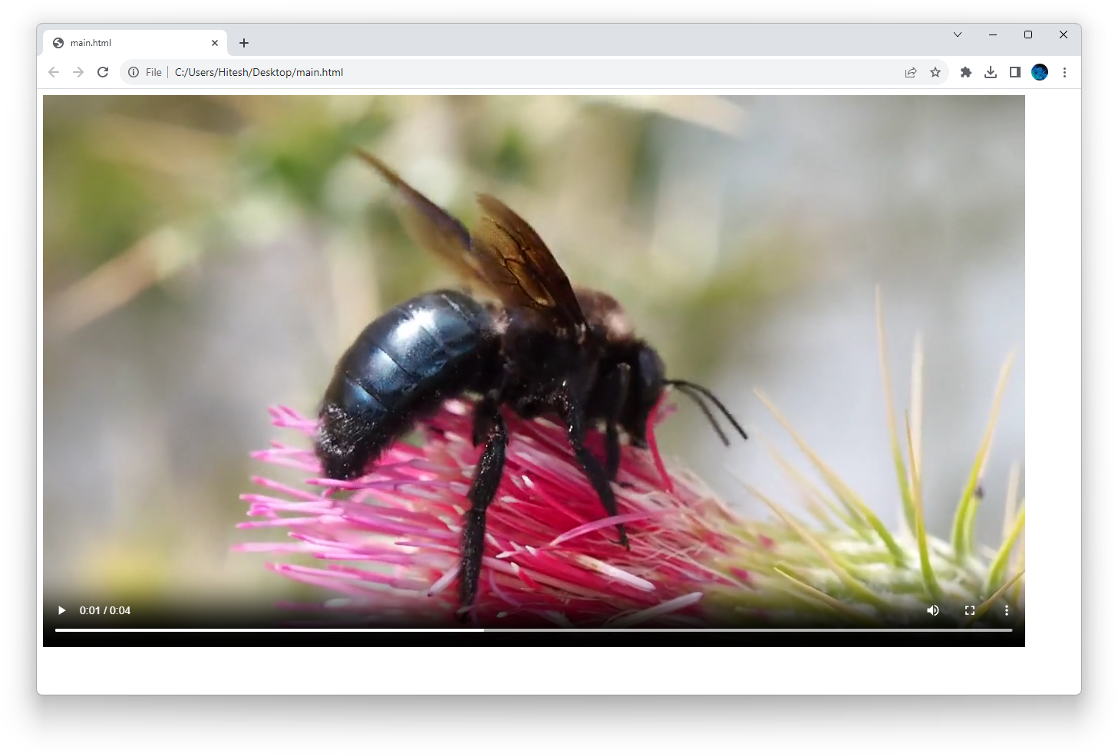
Introduction:
Video playback in web-browsers.
<!DOCTYPE html>
<html lang="en">
<body>
<video controls src="static/bee.mp4">
</body>
</html>
All modern web-browsers e.g. Google Chrome, Mozilla Firefox & Microsoft Edge etc. use FFmpeg under the hood for all kind of video/audio!
https://www.chromium.org/audio-video/
Key Considerations:
  Magnitude
  Performance
  Stability
  Range
  …

Slide 7
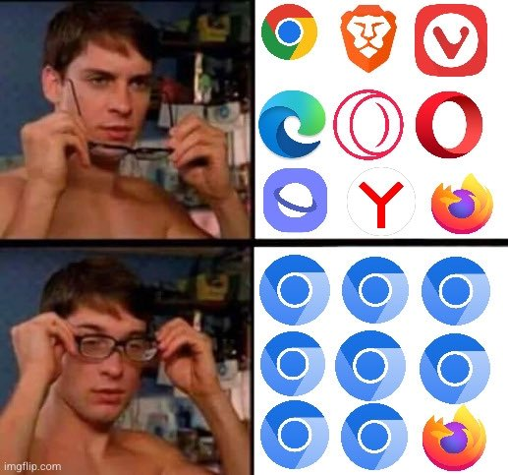
Introduction:
Web-browser engines.

Slide 8
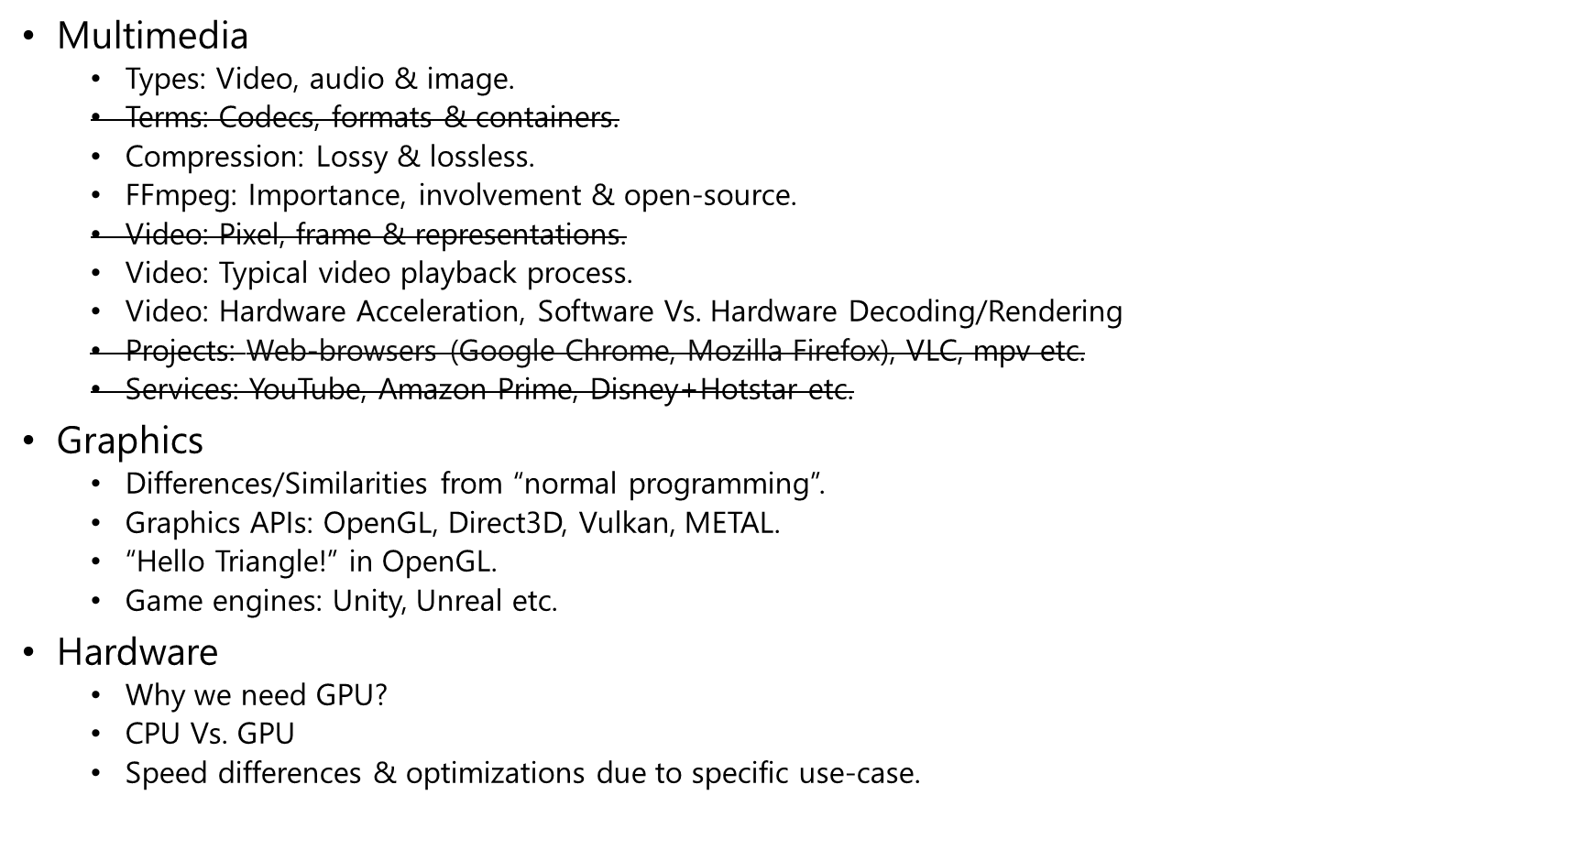












Table of Contents

Slide 9
Multimedia: Types
Video
  Moving visual content; generally combined with audio.
  Formats:
    HEVC (H.265), H.264, AV1, VP9, VP8 etc.
    Where is MP4 or MKV? Formats & Containers are different!
Image
  Static visual content.
  Formats:
    JPEG, WEBP, PNG, BMP, TIFF, GIFF etc.
Audio
  Audible content.
  Formats:
    MP3, AAC, OPUS, Vorbis, FLAC, ALAC etc.

Slide 10
Compression: Lossy & lossless
Lossy compression
  The resulting file size is reduced.
  Some information from the original file is lost e.g. quality of video or audio.
  e.g. MP3, JPEG etc.
Lossless compression
  The resulting file size is reduced.
  No information is lost.
  e.g. FLAC, BMP etc.

Slide 11
Compression: Intra-frame & Inter-frame (video-specific)

Slide 12


FFmpeg
Allows to stream, play, encode, decode, convert (or just about anything else) a piece of multimedia content i.e. video, audio or image.
Supports all multimedia codecs, formats & protocols on the planet.
Powers large amount of software & used by big-tech.
Written in C & ASM to avoid OS-level or platform-specific abstractions i.e. cross-platform.
Free & open-source. Developed under the GNU Lesser General Public License (LGPL).
May be used as a standalone CLI application or C library.
www.ffmpeg.org
Tools: ffmpeg, ffprobe, ffplay

Slide 13
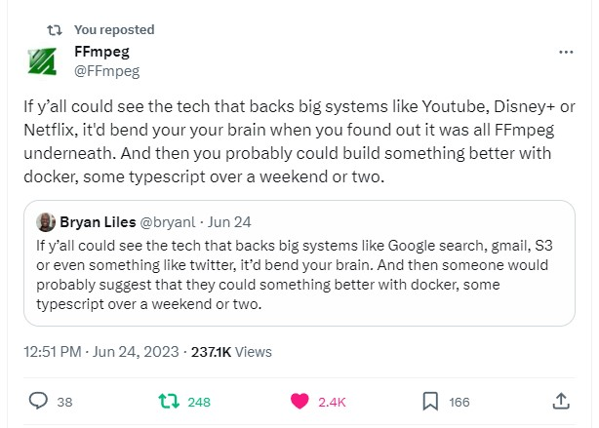
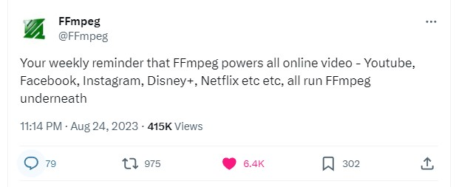
FFmpeg

Slide 14
FFmpeg
libavcodec: provides implementation of a wider range of codecs.
libavformat: implements streaming protocols, container formats and basic I/O access.
libavutil: includes hashers, decompressors and miscellaneous utility functions.
libavfilter: provides means to alter decoded audio and video through a directed graph of connected filters.
libavdevice: provides an abstraction to access capture and playback devices.
libswresample: implements audio mixing and resampling routines.
libswscale: implements color conversion and scaling routines.
CLI
$ ffmpeg -i input.mp4 output.avi
$ ffmpeg -i input_video.mp4 -vn -acodec mp3 output_audio.mp3
C API
#include "libavformat/avformat.h"
#include "libavcodec/avcodec.h"
#include "libavfilter/avfilter.h"
#include "libavutil/avutil.h"
#include "libswresample/swresample.h"

Slide 15
Video: Typical video playback process.
Protocol
  A protocol refers to the method or rules used for communication between different components, such as fetching multimedia data from a specific source like a file, network stream, or device.
  Examples: HLS, RTSP, RTMP, HTTP, HTTPS, PIPE, FD, FILE.
Parser
  A parser is responsible for interpreting the structure of multimedia data, such as breaking down a multimedia file into its constituent parts, like video frames and audio samples. It helps in understanding the format and extracting relevant information.
Demuxer
  A multimedia file generally contains one or more streams e.g. a video file may contain multiple video, audio or subtitle tracks.
  The demuxer separates the combined audio and video streams from a multimedia container (e.g., MP4, MKV) into individual streams. It extracts the different elements (audio, video, subtitles) for further processing.
Decoder
  Decoding involves converting compressed audio or video data into a format that can be played or manipulated. Decoders are responsible for decompressing the multimedia data so that it can be processed for playback or editing.
Renderer
  The final step to display the decoded video frame (frame-buffer or texture) or audio frame (PCM).
  The renderer is the component responsible for displaying or playing back the decoded multimedia content. It takes the processed audio and video data and outputs it to the display or audio playback device.
NOTE: During FFmpeg compilation, one can manually select the supported protocols/parsers/demuxers/decoders.

Slide 16
Video: Hardware Acceleration, Software Vs. Hardware Decoding/Rendering
“Hardware acceleration” from Google:
  Hardware acceleration is the use of computer hardware designed to perform specific functions more efficiently when compared to software running on a general-purpose central processing unit.
What does it mean in context of video playback?
  CPU is good at general-purpose computation e.g. if, else if, for, while.
  CPU is not good at handling/transforming/processing large amount of data as a video frame buffer.
  GPU is excellent & far more efficient (speed & energy consumption) at this job.
  We can still make CPU do GPU’s job (recall it’s a general-purpose computation). Thus, software-decoding/rendering. However, that results in decreased performance & very-high power consumption (less battery-life). It is near impossible to go beyond 1080p.
  Most SoC/chipset have built-in hardware decoders for most codecs e.g. H.264, H.265, AV1.

Slide 17
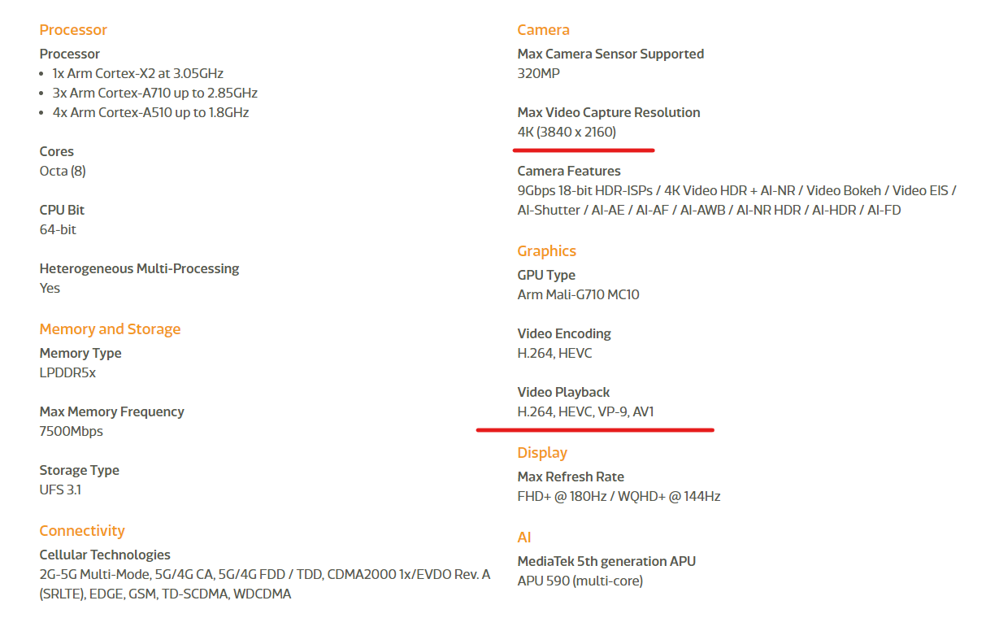
Video: Hardware Acceleration, Software Vs. Hardware Decoding/Rendering
Specification of MediaTek Dimensity 9000:
  https://www.mediatek.com/products/smartphones-2/mediatek-dimensity-9000

Slide 18
Graphics: Introduction
To make use of GPU’s capabilities, conventional programming language (alone) isn’t enough.
Different platforms provide different abstractions in form of APIs to access GPU:
OpenGL is most “widely accepted” and also works on Windows & macOS. However:
  OpenGL on Windows is not performant (issue with manufacturer drivers & first-party support from Microsoft).
  Apple deprecated OpenGL since macOS 10.14 Mojave.
Microsoft Windows | Direct3D / DirectX
Apple macOS / iOS | METAL
Android | OpenGL ES
Cross-Platform | OpenGL, Vulkan

Slide 19
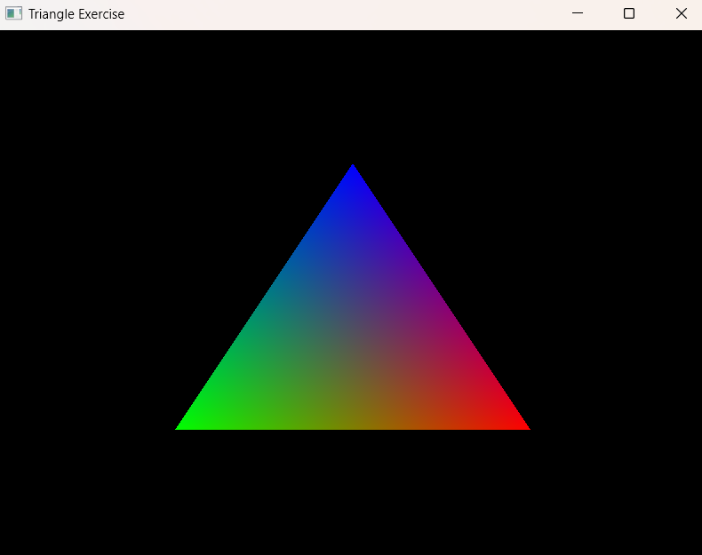
Graphics: “Hello Triangle!” in OpenGL
https://learnopengl.com/Getting-started/Hello-Triangle
Every piece of content is essentially made up of triangles.
A number of concepts are involved:
VBO: Vertex Buffer Object
FBO: Frame Buffer Object
Shaders:
  Vertex Shader
  Fragment Shader
API provided by OpenGL:
  glGenVertexArrays
  glGenBuffers
  glVertexAttribPointer
  glBindVertexArray
  glClear
  glDrawArrays
  glShaderSource
  glCompileShader
  glAttachShader
  glLinkProgram
Most game-engines e.g. Unity, Unreal, COCOS2D etc. provide abstraction.

Slide 20
Graphics: ANGLE
ANGLE: Almost Native Graphics Layer Engine
Free & open-source. Developed under the BSD 3-Clause License.
Started-off by Google. Contributed by Microsoft, Apple, Intel, ARM, Samsung, Adobe etc.
ANGLE internally translates OpenGL ES to underlying platform’s hardware-supported API i.e. DirectX on Windows, METAL on macOS etc.
Simpler terms:
Use OpenGL ES on every-platform without (very-little) compromising performance.
https://github.com/google/angle

Slide 21
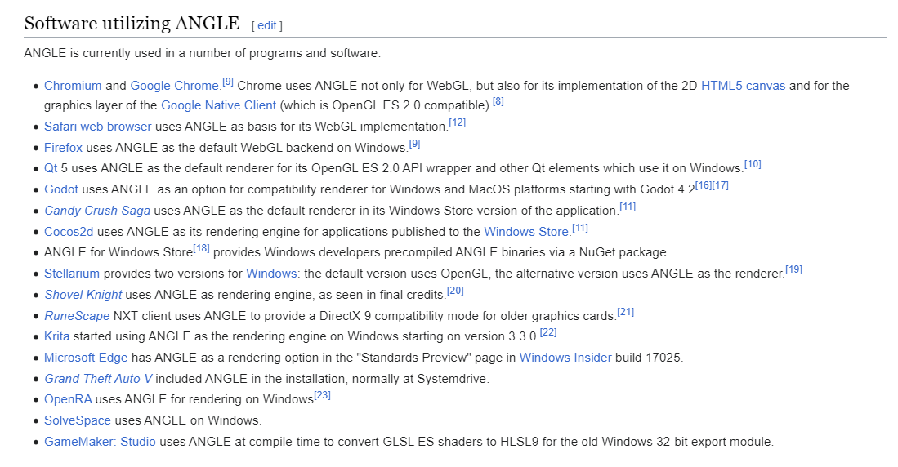
Graphics: ANGLE

Slide 22
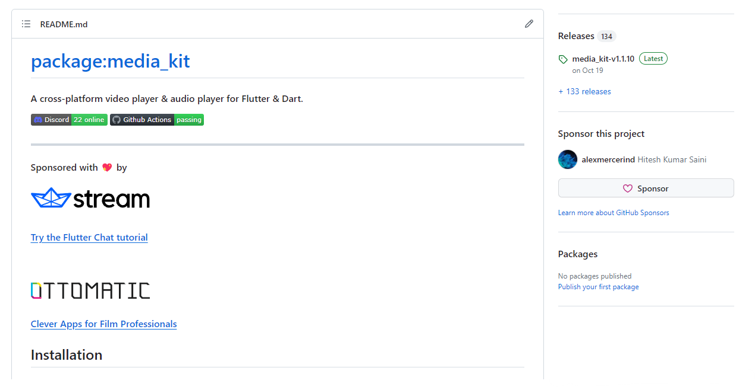
Personal Project: media_kit
https://github.com/media-kit/media-kit

Slide 23
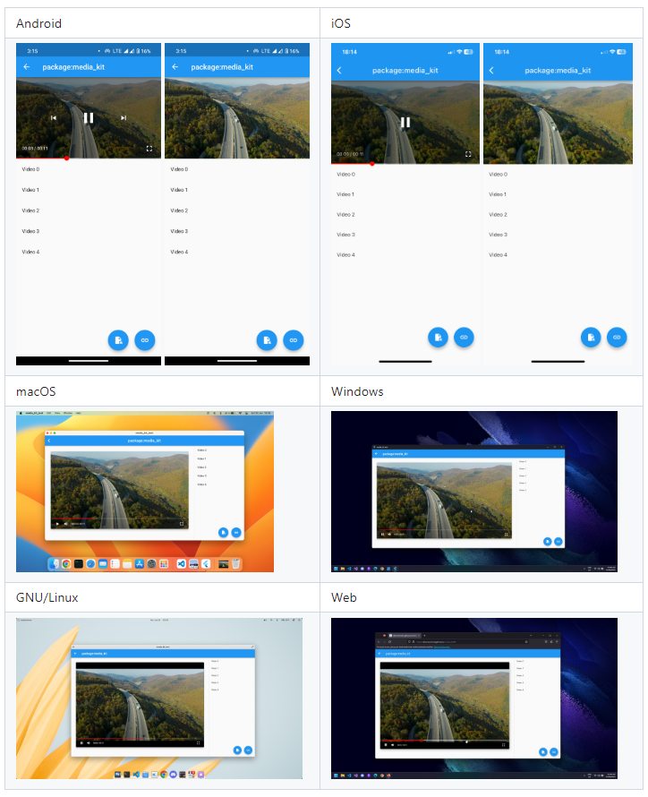
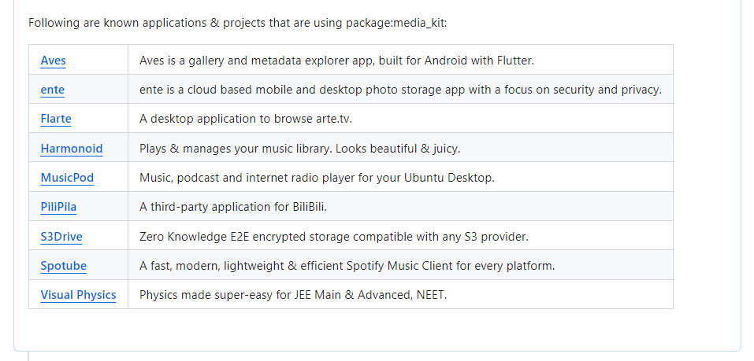
Personal Project: media_kit

Slide 24

Thank You
Questions?
Hitesh Kumar Saini
56195
@alexmercerind
@alexmercerind

